Slide 1
Troop 300 – Monthly Rank Workshop
October 20, 2020

Slide 2
Scout Rank Requirements

Slide 3
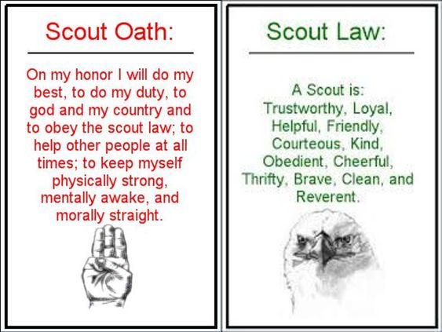

Slide 4
Scout Motto
“Be Prepared”
Scout Slogan
“Do a good turn daily”

Slide 5
Requirement 2a.
After attending at least one Boy Scout troop meeting, do the following; Describe how the scouts in the troop provide its leadership (pages 42-44)

Slide 7
Requirement 2b.
After attending at least one Boy Scout troop meeting, do the following; Describe the four steps of Boy Scout advancement. (see pages 413-416.)

Slide 9
Requirement 2c.
After attending at least one Boy Scout troop meeting, do the following; Describe what the Boy Scout ranks are and how they are earned. (see pages 27, 413-416.)

Slide 11
Requirement 2d.
After attending at least one Boy Scout troop meeting, do the following; Describe what merit badges are and how they are earned. (see pages 416-418.)

Slide 13
Requirement 3a.
Explain the patrol method. Describe the types of patrols that are used in your troop. (see pages 25.)

Slide 15
Requirement 3b.
Become familiar with your patrol name, emblem, flag, and yell. Explain how these items create patrol spirit. (see pages 26.)

Slide 17
Totin’ Chip

Slide 18
Totin’ Chip Requirements
1. Read and understand woods tools use and safety rules found in the BS Handbook. (pages 378-386.)
2. Demonstrate proper handling, care, and use of the Ax, Saw and Pocket Knife.
3. Use the Ax, Saw, and knife as tools not playthings.
4. Respect all safety rules to protect others.
5. Respect property. Cut only dead and living trees with permission and good reason.
6. Subscribe to the Outdoor Code. (pages 223-224.)

Slide 19
Earning Totin’ Chip fulfills the following;
Scout Rank requirement 5.
Tenderfoot Rank requirement 3d.

Slide 20
Thank You
Please remember to track your progress, so a leader can sign your requirements off next time we meet.

