Slide 1

Troop 300 – Monthly First Year Scouts Meeting
November 17, 2020

Slide 2



Firem’n Chit

Slide 3

Requirements;
Read and understand fire use and safety rules from the Boy Scout Handbook.
Build a campfire only when necessary and when having necessary permits (regulations vary by locality).
Minimize campfire impacts or use existing fire lays consistent with the principles of Leave No Trace. Check to see that all flammable material is cleared at least 5 feet in all directions from fire (total 10 feet).
Safely use and store fire starting materials.
See that fire is attended to at all times.
Make sure that water and/or a shovel is readily available. Promptly report any wildfire to the proper authorities.
Use the cold-out test to make sure the fire is cold out and make sure the fire lay is cleaned before leaving.
Follow the Outdoor Code, the Guide to Safe Scouting, and the principles of Leave No Trace and Tread Lightly!.

Slide 4
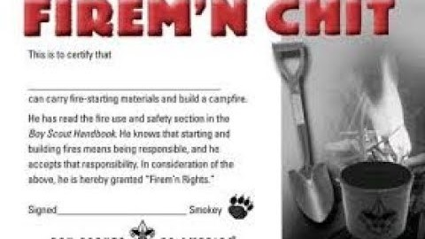


Slide 5
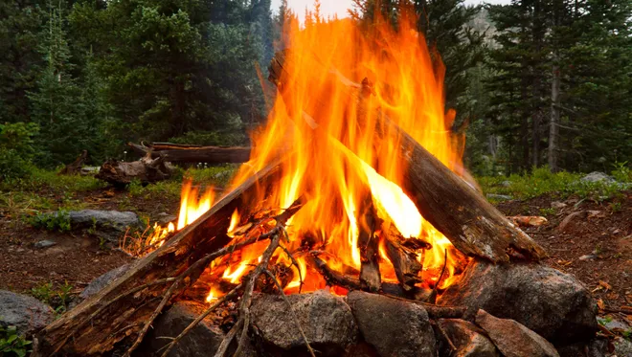
Fire Building

Slide 6

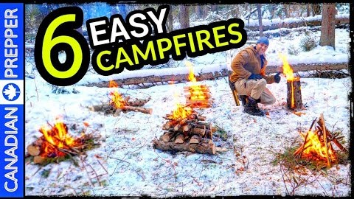

Slide 7
Starting a fire without matches

Slide 8
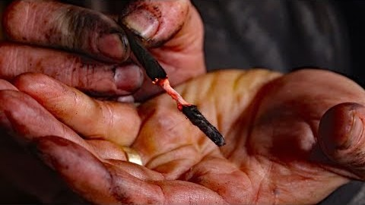

Slide 9

Thank You
Please remember to track your progress, so a leader can sign your requirements off next time we meet.

