Slide 1




Troop 300 – Weekly Meeting
September 15, 2020

Slide 2

Scout Rank Requirements

Slide 3
Requirement 1a.
Repeat from memory the Scout Oath, Scout Law, Scout Motto, and Scout Slogan. In your own words, explain their meaning. (see pages 11-18.)

Slide 4


Slide 5
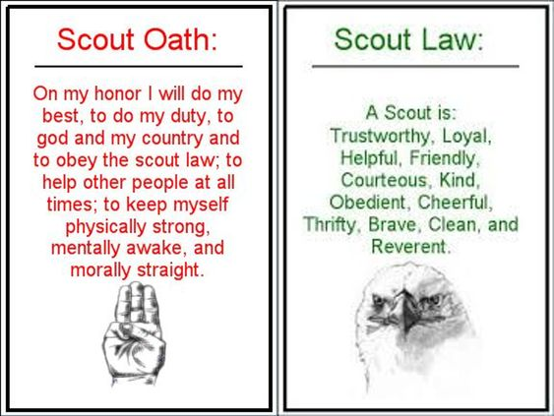

Slide 6

Scout Motto
“Be Prepared”
Scout Slogan
“Do a good turn daily”

Slide 7
Requirement 1b.
Explain what Scout spirit is. Describe some ways you have shown Scout spirit by practicing the Scout Oath, Scout Law, Scout motto, and Scout slogan. (see page 15.)

Slide 8


Slide 9
Requirement 1c.
Demonstrate the Boy Scout sign, salute, and handshake. Explain when they should be used. (see pages 18-19.)

Slide 10


Slide 11
Requirement 1d.
Describe the First Class Scout badge and tell what each part stands for. Explain the significance of the First Class Scout badge. (seepages 19-20.)

Slide 12


Slide 13
Requirement 1f.
Repeat from memory the Pledge of Allegiance. In your own words, explain its meaning. (see pages 60.)

Slide 14


Slide 15

Totin’ Chip

Slide 16
Totin’ Chip Requirements
1. Read and understand woods tools use and safety rules found in the BS Handbook. (pages 378-386.)
2. Demonstrate proper handling, care, and use of the Ax, Saw and Pocket Knife.
3. Use the Ax, Saw, and knife as tools not playthings.
4. Respect all safety rules to protect others.
5. Respect property. Cut only dead and living trees with permission and good reason.
6. Subscribe to the Outdoor Code. (pages 223-224.)

Slide 17
You will learn how to;
1. How to select, care for, sharpen, and use a pocket knife.
2. How to use and care for a camp saw.
3. How to care for, identify the part of, sharpen, and use an axe.
4. Will demonstrate the use of a pocket knife, camp saw, and axe.
5. Will demonstrate the sharpening of a knife and axe.
6. Safety expectations when using all camp tools.
7. Understand the outdoor code

Slide 18
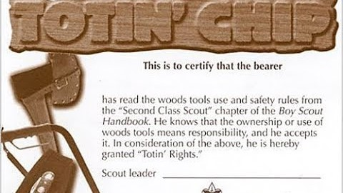

Slide 19

Earning Totin’ Chip fulfills the following;
Scout Rank requirement 5.
Tenderfoot Rank requirement 3d.

Slide 20

Thank You
Please remember to track your progress, so a leader can sign your requirements off next time we meet.

